Slide 1
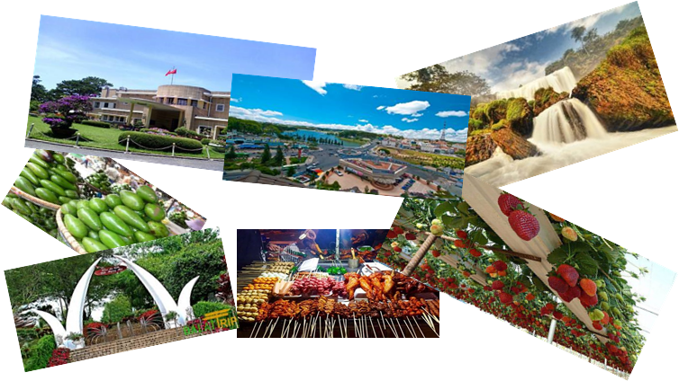
Group 1
Talking about interesting things in
Da Lat city

Slide 2

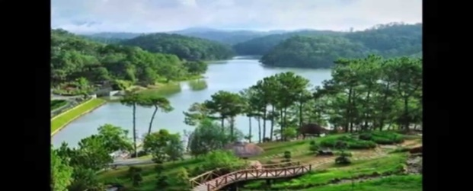
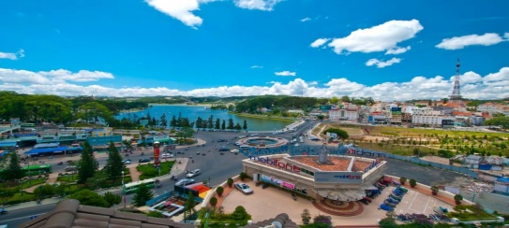
Located in the center of
Southern highland ,
300kilometer far from
the North of
Ho Chi Minh city

Slide 3

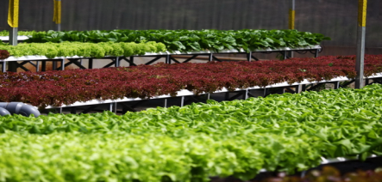
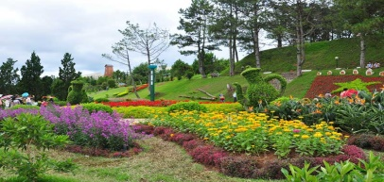
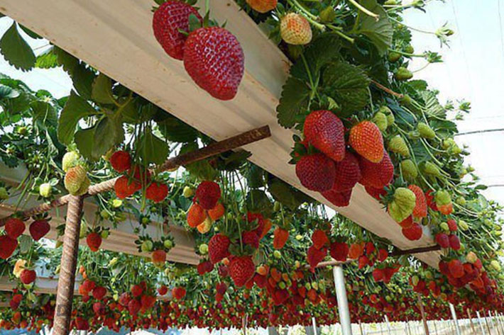
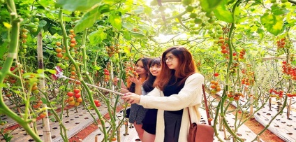
.
The weather is cool .Da Lat has many kinds of
beautiful and precious flowers, , vegetables , beautiful landscapes and fruits

Slide 4

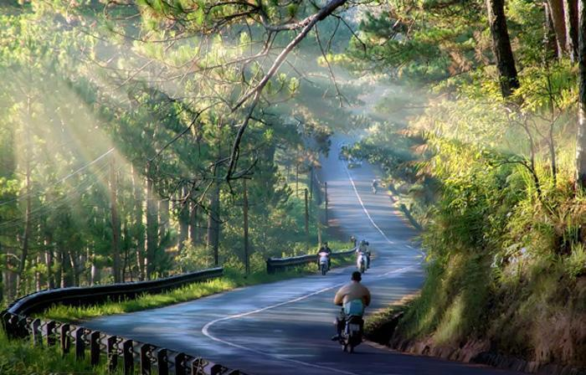
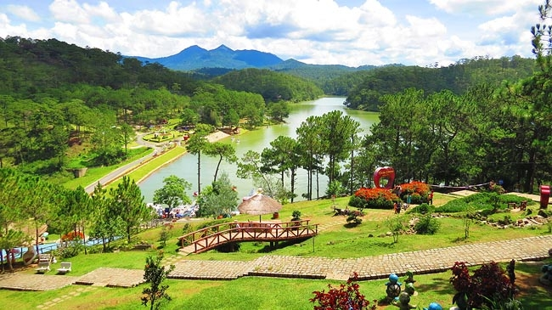
Spreading across a series of pine covered hills

Slide 5
Three sections:
1.THE CITY CENTER.
2.THE NORTH OF CITY CENTER
3.THE SOUTH OF CITY CENTER

Slide 6

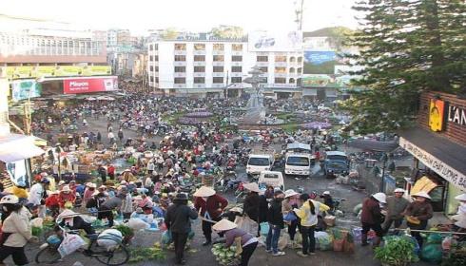
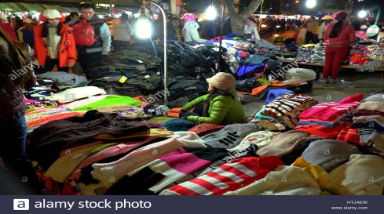
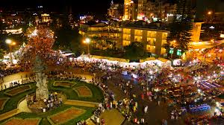
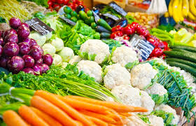
Da Lat Market

Slide 7

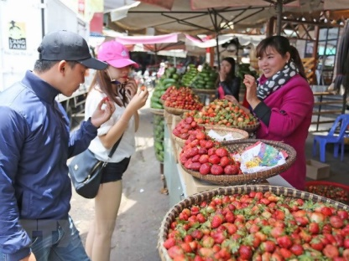
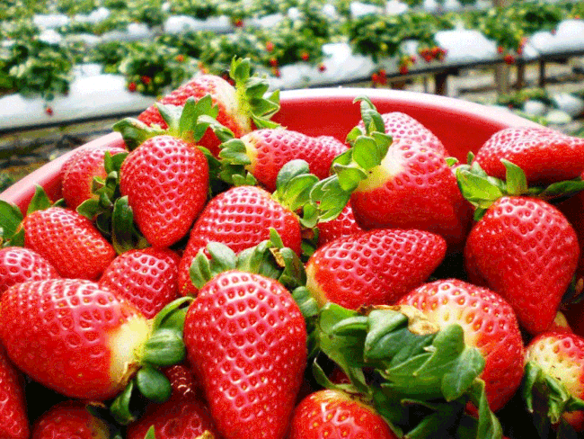
Strawberry

Slide 8
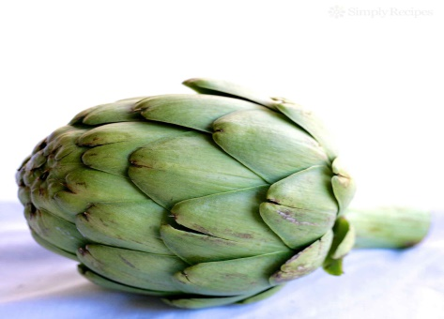
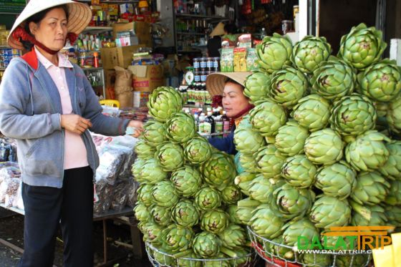
Atiso

Slide 9
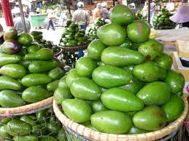
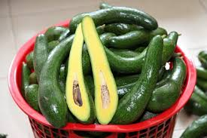
avocado

Slide 10
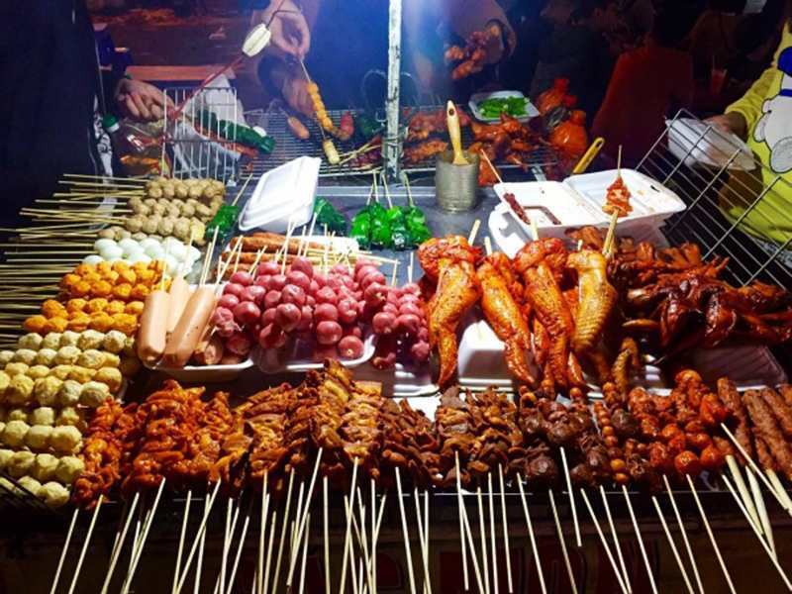
Street foods at the center of Dalat

Slide 11
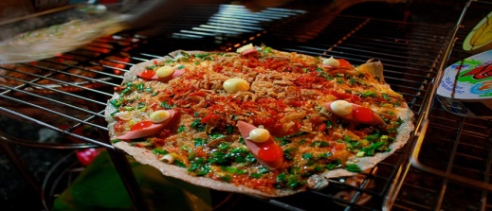
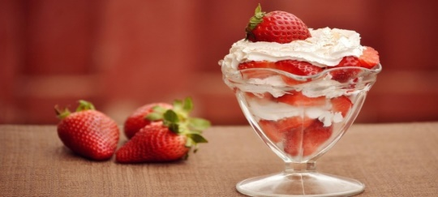
Strawberry Ice-cream
Grilled rice paper

Slide 12

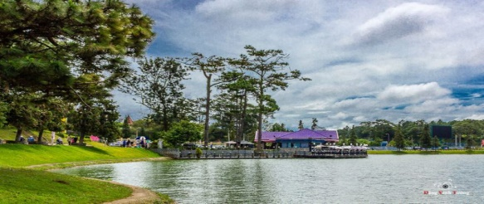
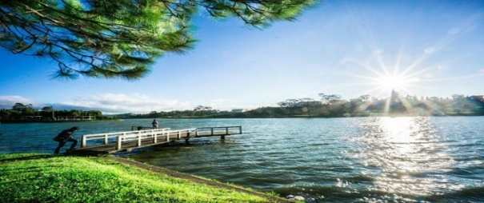
Xuan Huong Lake is
a beautiful lake
in the heart of Da Lat.
.

Slide 13

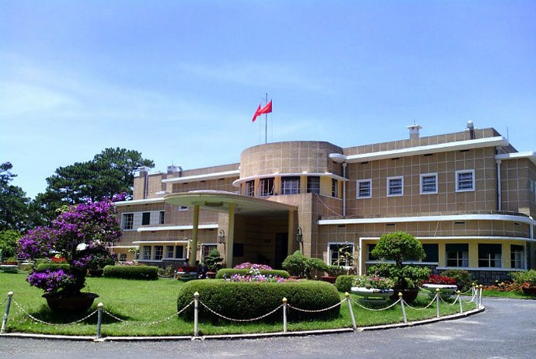
Bao Dai Mausoleum:
is located on a high hill , occupying
a large area covered with
pine forests surrounding

Slide 14

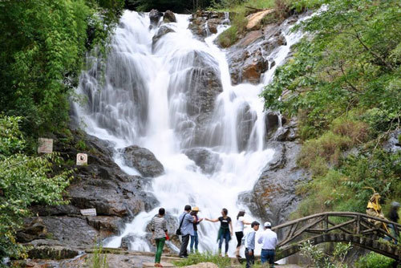
Datanla Waterfall is a large waterfall located in Datanla Tourist Area about 10 km from the center of Da Lat.It is considered as one of the most wonderful Da Lat attractions with deep and much flow waterfall.

Slide 15

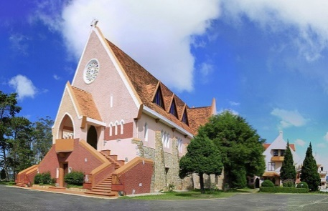
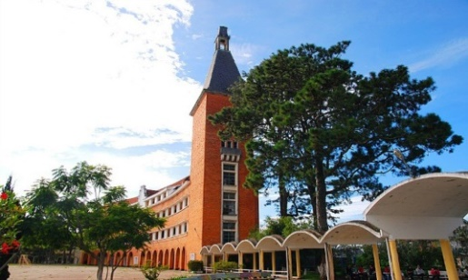
Domaine de Marie Church
Dalat Teacher’s Training College

Slide 16

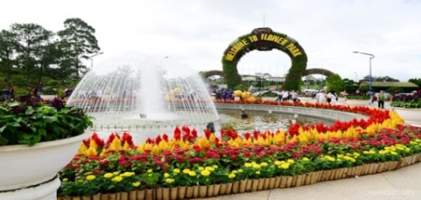
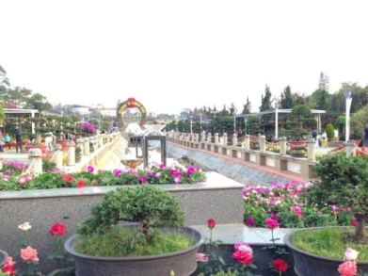
Dalat Flower Garden
There are some of the 300 different types of common flowers displayed in these parks along with a lot of other exotic flowers.

Slide 17
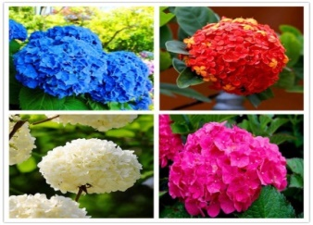
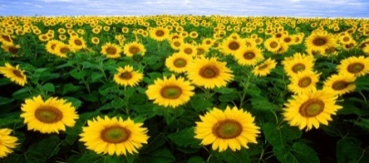
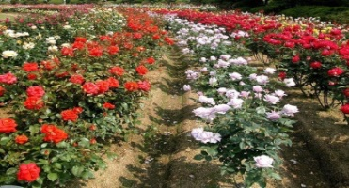
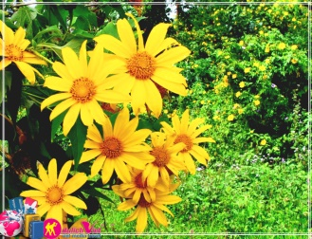
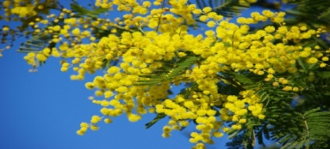
Wild sunflowers
Rose
Hydrangea
Da quy
mimosa

Slide 18

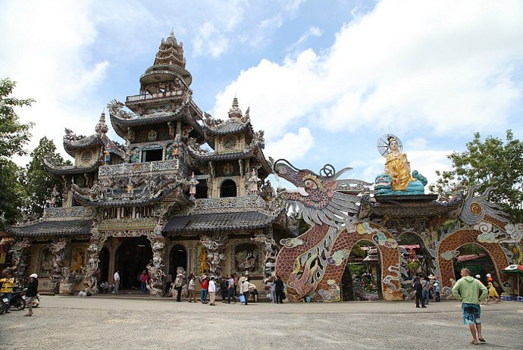
Linh Phuoc pagoda
This pagoda is also known as Bottle pagoda as in the yard of the pagoda there is a 49m long dragon made of 12000 bottles

Slide 19

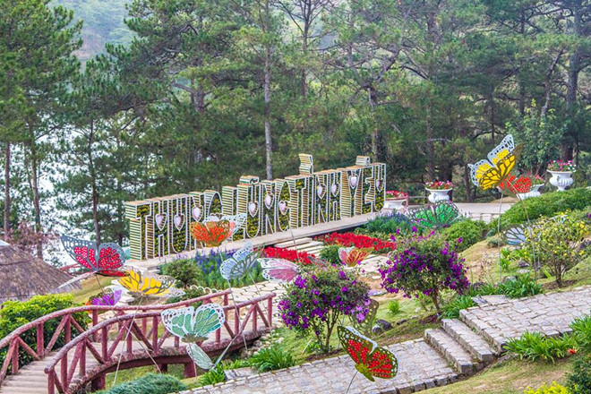
is one of the most romantic landscapes, about 5km to the north of the center of Da Lat city
Valley of Love

Slide 20
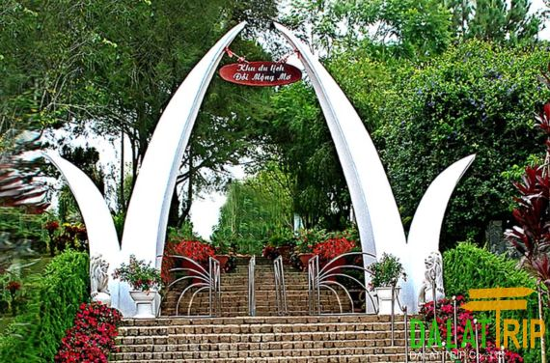
For its poetic landscape, people call the Dreaming Hill a small Da Lat

Slide 21

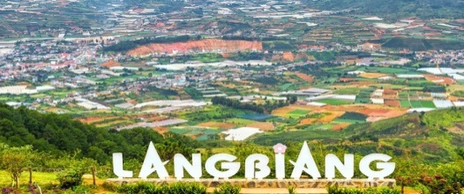
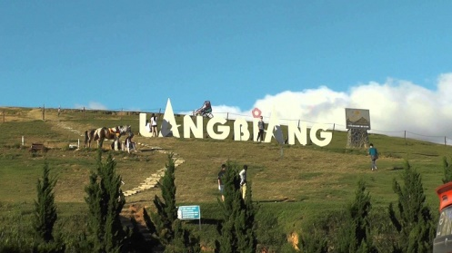
Lang Biang Mountain :
`
- 2,167m above the sea level
- Called the “roof” of Da Lat.

Slide 22

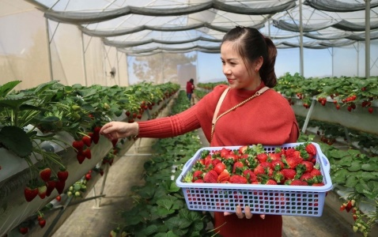
Strawberry Gardens :Thanks to the cool weather,Da Lat is very ideal for many types of fruits and vegetables, particularly strawberries.

Slide 23
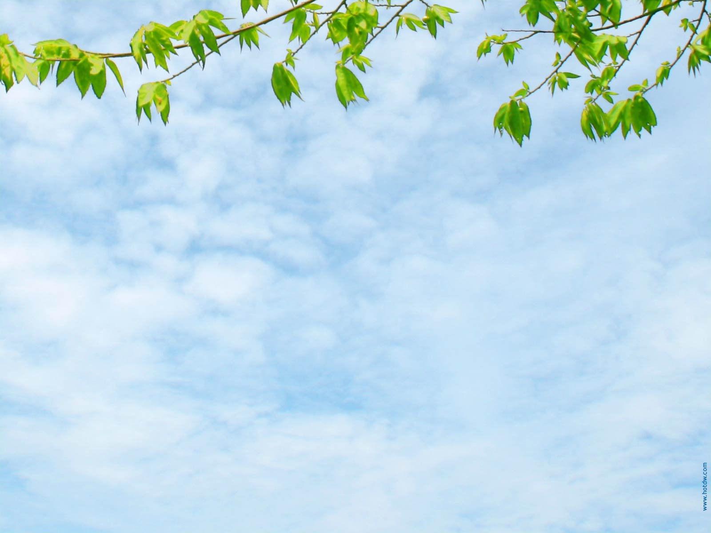
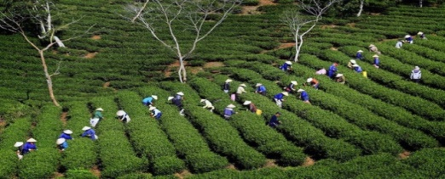
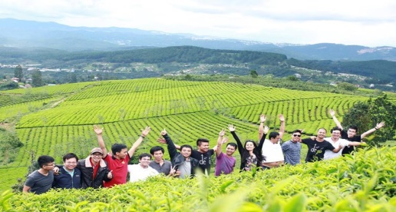
Cau Dat Farm
.
The tea farm has now over 200 hectares.
These beautiful landscapes have
become a destination attracting
a large number of visitors

Slide 24

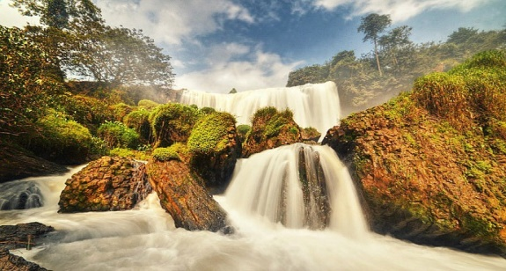
Elephant Waterfall
- Located in Nam Ban (Nam Ban) town, about 40km away from Da Lat.
the height : over 30m
the width : 15m.

Slide 25

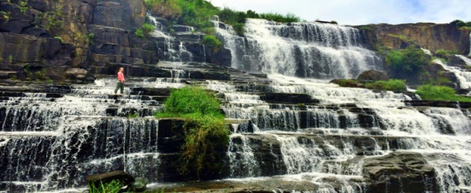
,
Pongour Waterfall is one of the most famous waterfalls and the biggest falls in Da Lat.

Slide 26

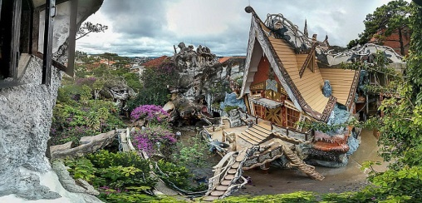
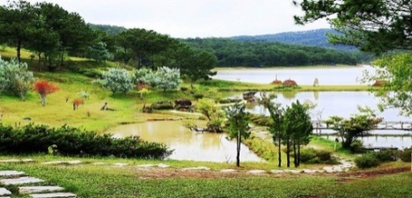
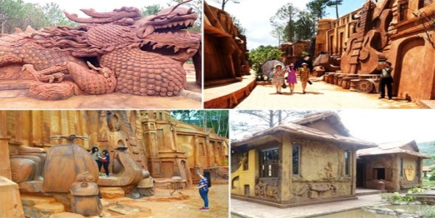
Golden Valley
Hang Nga Guesthouse
Dalat Clay Sculptures
Tunnel

Slide 27

Small Game
Multiple choice

Slide 28
1. How do you go to Da Lat?
by car
by train
by plane
A &C are correct
D. A &C are corrects

Slide 29
2. How about the weather in Da Lat?
A. cool weather
B. dry weather
C. hot weather
D. rainy weather
A. cool weather

Slide 30
3. What is the most famous fruit in Da Lat?
A. atiso
B. strawberry
C. green tea
D. banana
B. strawberry

Slide 31
4. Which place are not mentioned in the talk?
Valley of Love B. Dalat Flower Garden
C. Dreaming Hill D. Cam Ly waterfall
D. Cam Ly waterfall

Slide 32
5.Which place do you like best in Da Lat? Why?
I like Da Lat flower garden best.
Because it has a lot of beautiful flowers and landscapes.

Slide 33
Thank for your attention!

